Slide 1
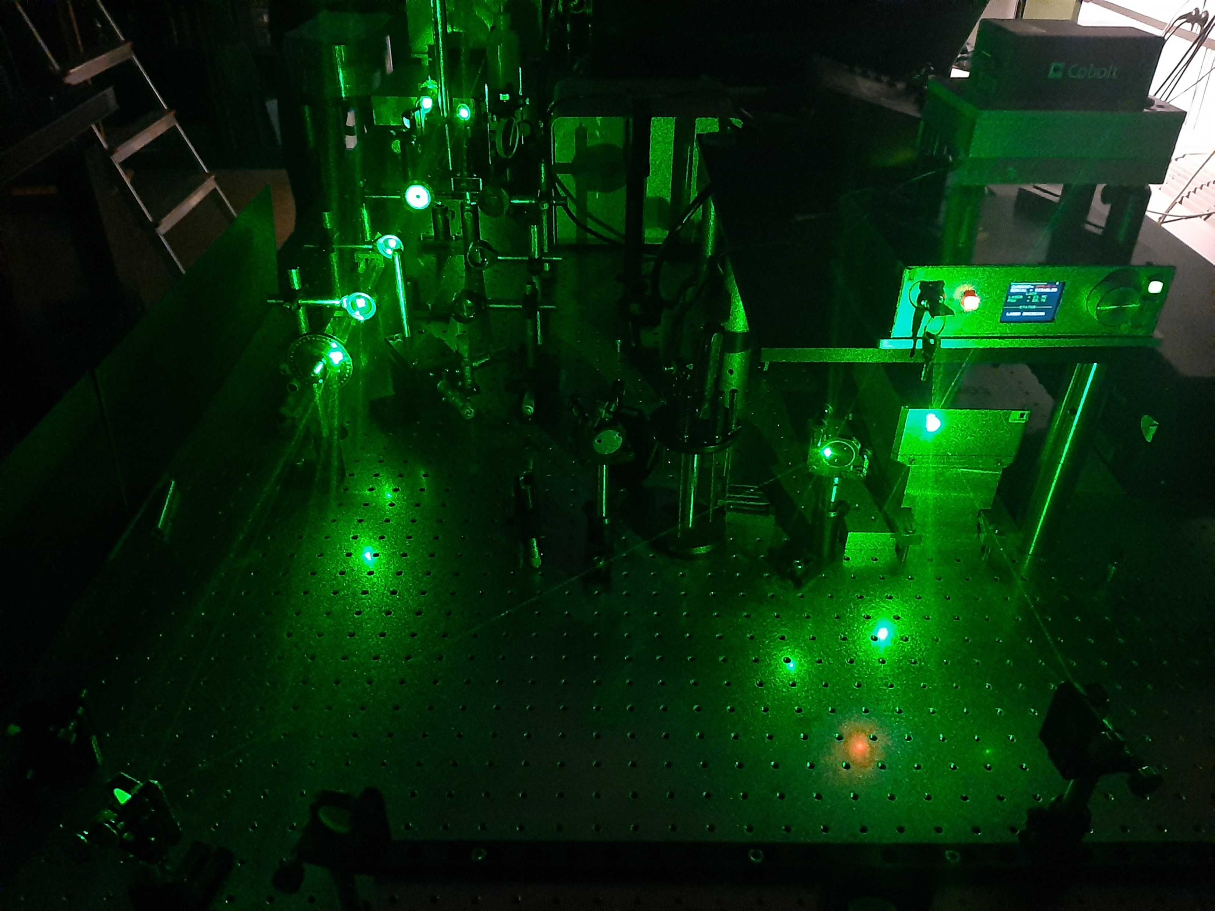
Advanced Physics Lab Ⅱ
2020312141 Donghun Jung
2020311441 Yujin Chon
Raman Spectroscopy
for Analyzing Chemical Structure

Slide 2
Outline
Outline
Introduction
/Theory
Raman Spectroscopy
Graphene Phonon Mode
Graphene Raman Spectrum
Experiment
/Results
GO, RGO, Graphite
Ti2CTx
Discussion
/Conclusion
Raman Spectrum

Slide 3
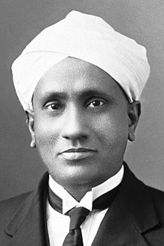
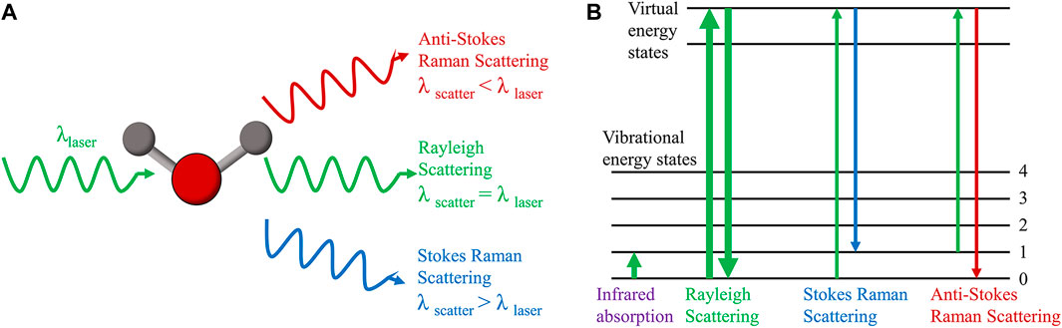
Raman Spectroscopy
Raman Shift
Raman scattering is inelastic photon scattering by matter. It is called Raman shift.

Slide 4
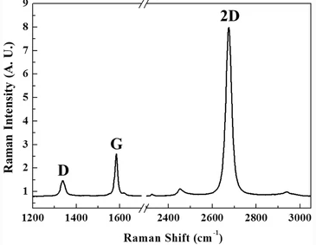


Raman Spectroscopy
Spectrometer
CCD

Slide 5

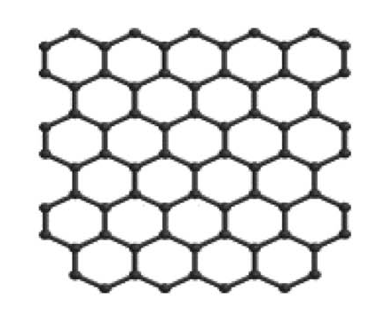
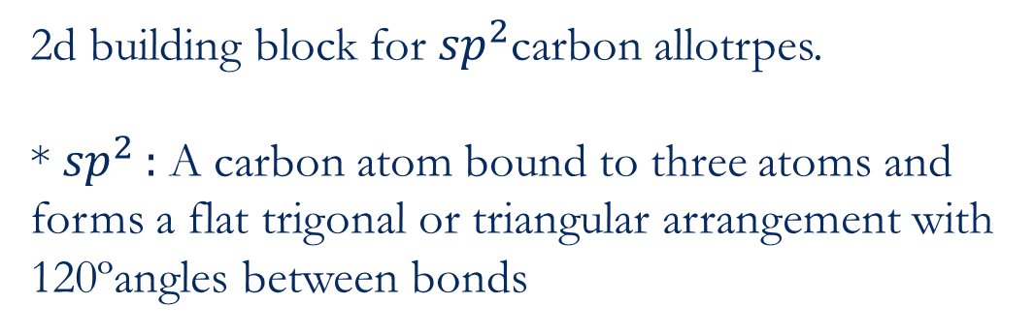
Graphene
2d building block for ${sp}^{2}$carbon allotrpes.
* ${sp}^{2}$ : A carbon atom bound to three atoms and forms a flat trigonal or triangular arrangement with 120ºangles between bonds

Slide 6
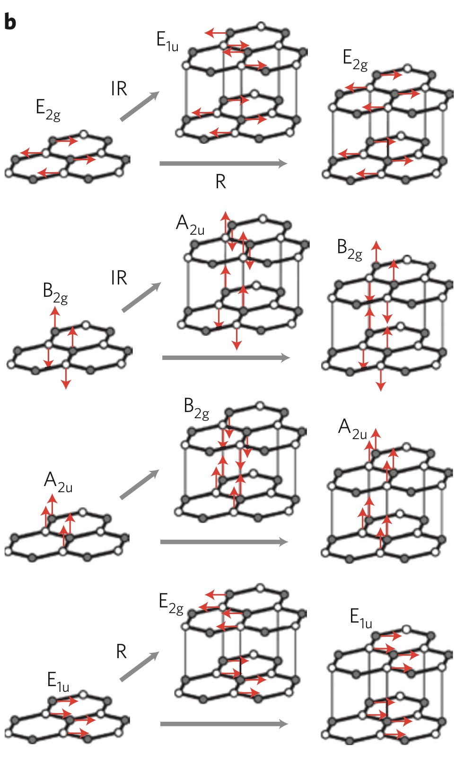
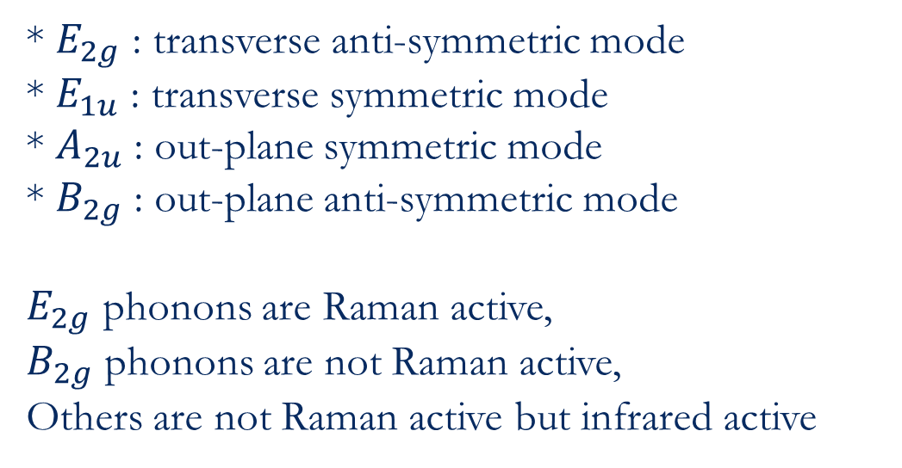
Graphene Phonon Normal Mode
* $E_{2g}$ : transverse anti-symmetric mode
* $E_{1u}$ : transverse symmetric mode
* $A_{2u}$ : out-plane symmetric mode
* $B_{2g}$ : out-plane anti-symmetric mode
$E_{2g}$ phonons are Raman active,
$B_{2g}$ phonons are not Raman active,
Others are not Raman active but infrared active

Slide 7
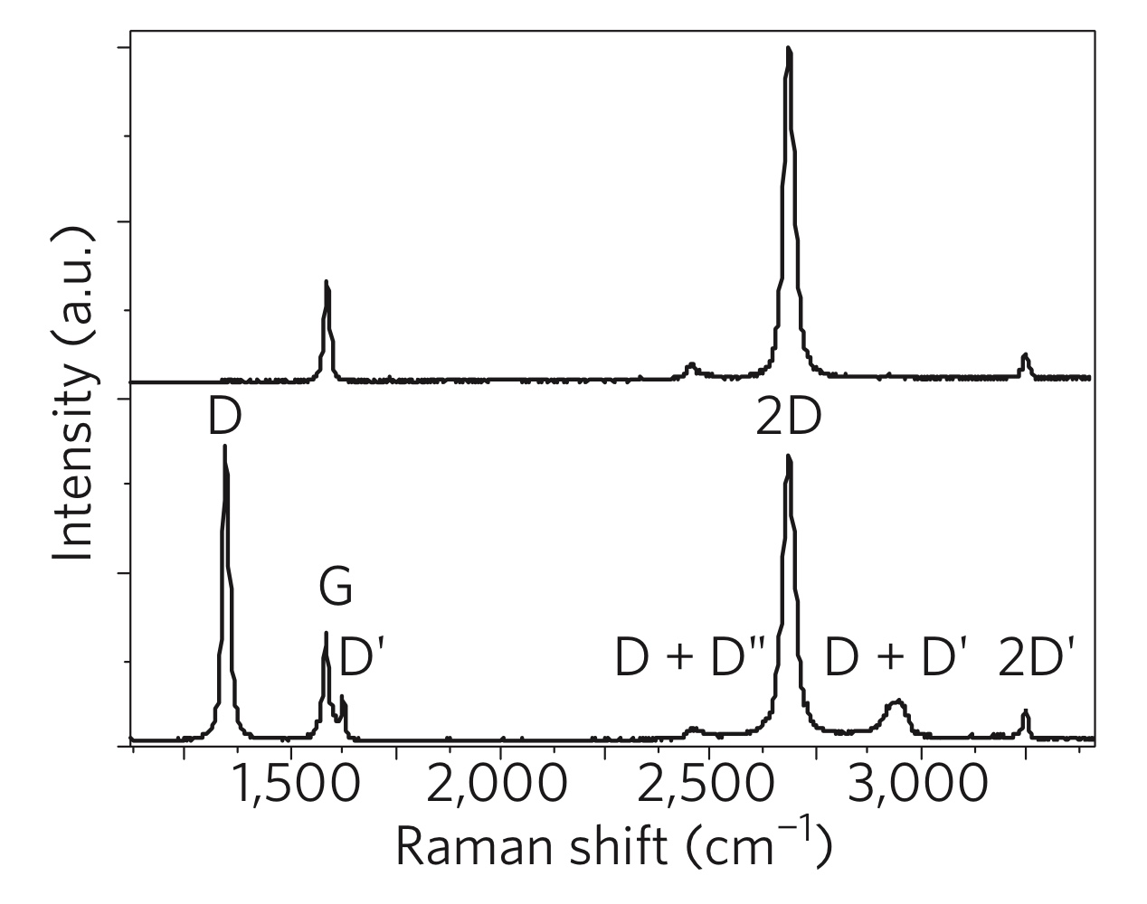
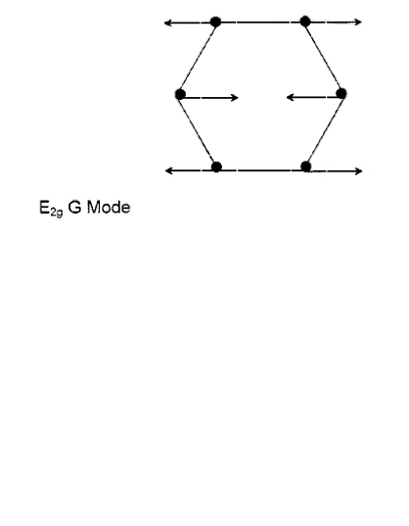
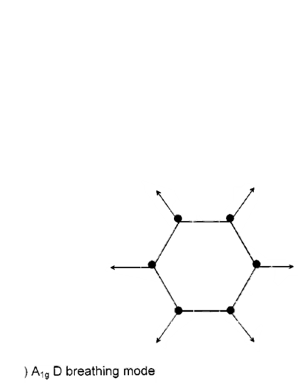
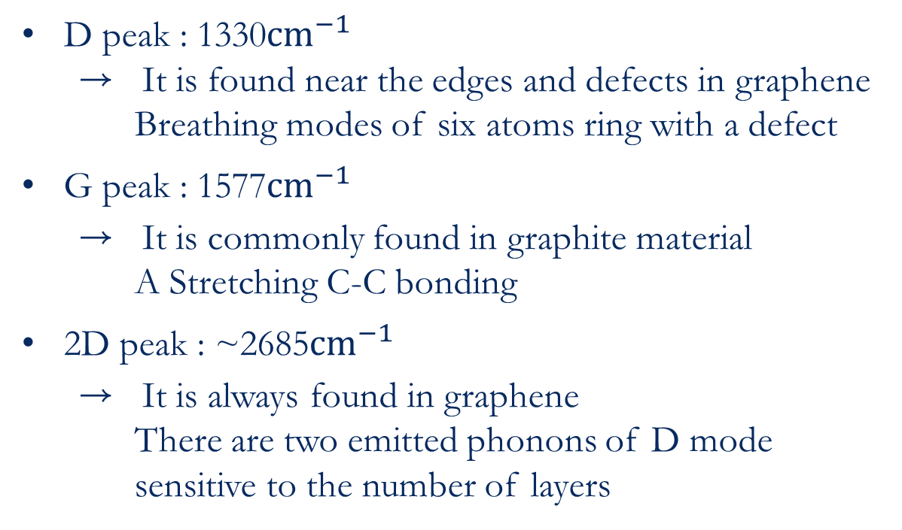
Graphene Raman Spectrum
D peak : 1330${cm}^{−1}$
→ It is found near the edges and defects in graphene Breathing modes of six atoms ring with a defect
G peak : 1577${cm}^{−1}$
→ It is commonly found in graphite material
A Stretching C-C bonding
2D peak : ~2685${cm}^{−1}$
→ It is always found in graphene
There are two emitted phonons of D mode
sensitive to the number of layers

Slide 8
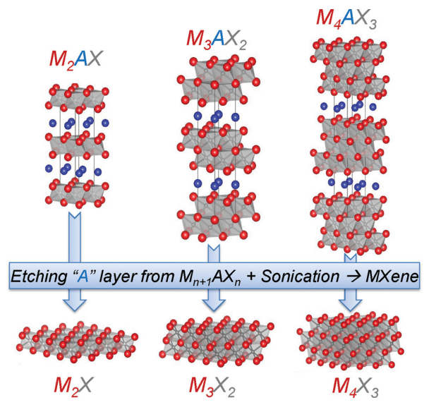
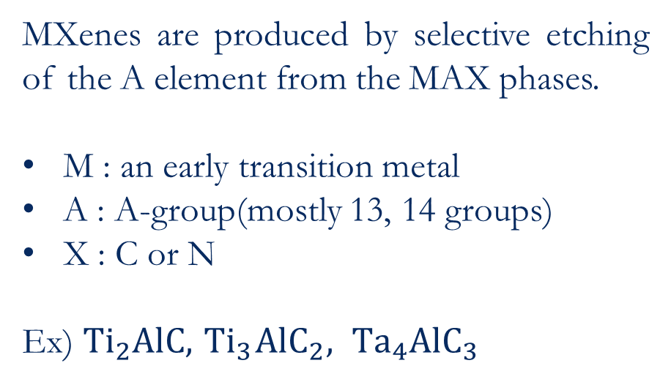
MXenes
MXenes are produced by selective etching of the A element from the MAX phases.
M : an early transition metal
A : A-group(mostly 13, 14 groups)
X : C or N
Ex) $Ti_{2}AlC, { Ti}_{3}{AlC}_{2}, {Ta}_{4}{AlC}_{3}$

Slide 9
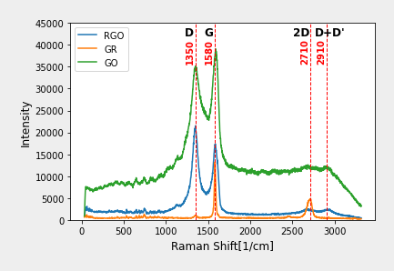
GO, RGO, Graphite – Experiment result

Slide 10
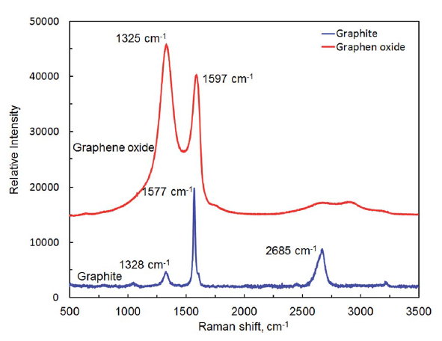
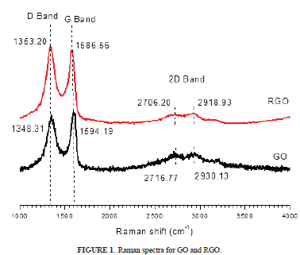
GO, RGO, Graphite

Slide 11
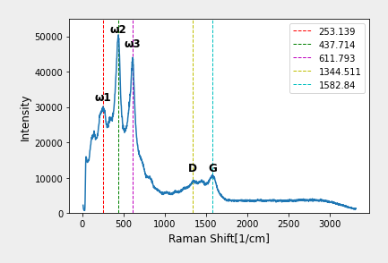
Ti2CTx – Experiment Result

Slide 12
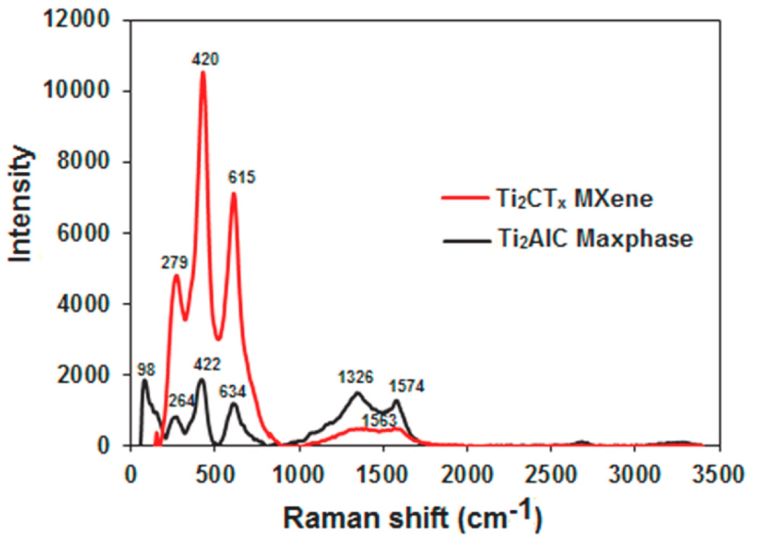
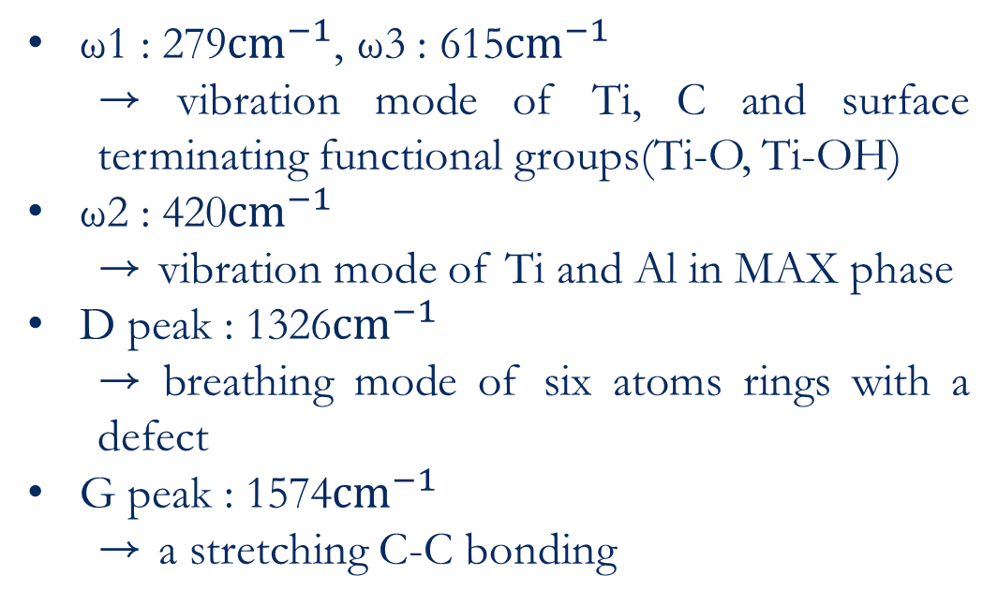
Ti2CTx
ω2
ω1 : 279${cm}^{−1}$, ω3 : 615${cm}^{−1}$
→ vibration mode of Ti, C and surface terminating functional groups(Ti-O, Ti-OH)
ω2 : 420${cm}^{−1}$
→ vibration mode of Ti and Al in MAX phase
D peak : 1326${cm}^{−1}$
→ breathing mode of six atoms rings with a defect
G peak : 1574${cm}^{−1}$
→ a stretching C-C bonding
ω3
ω1
D
G

Slide 13
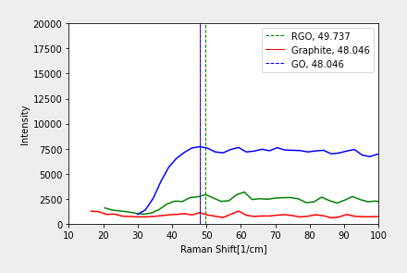
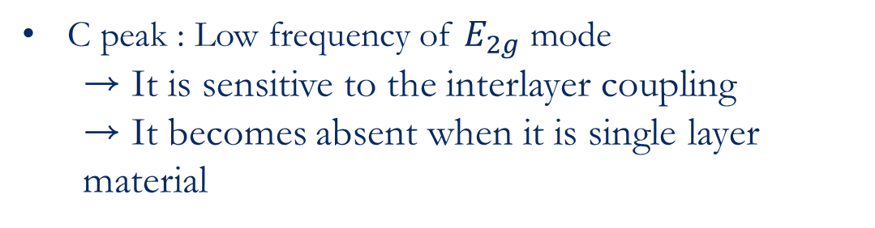
C peak
C peak : Low frequency of $E_{2g}$ mode
→ It is sensitive to the interlayer coupling
→ It becomes absent when it is single layer material

Slide 14
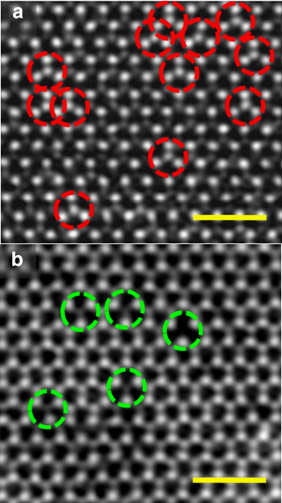
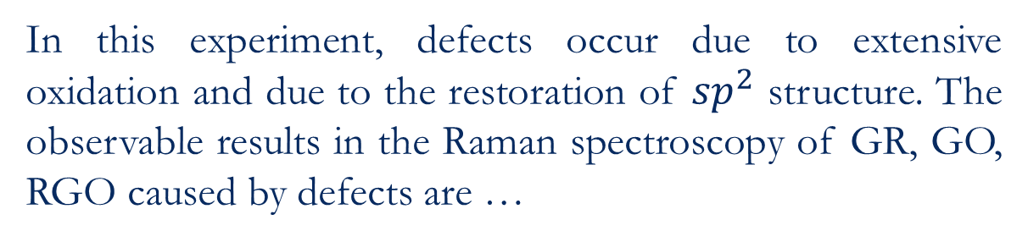
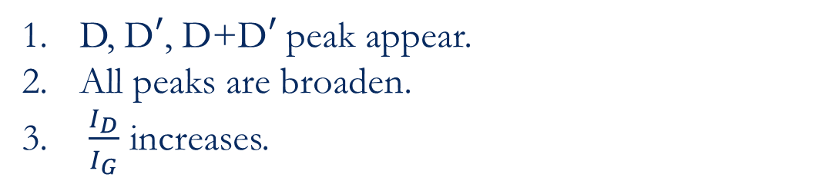
Defects
(Crystallographic) Defects are…
all the interruptions of regular patterns in crystalline solids.
In this experiment, defects occur due to extensive oxidation and due to the restoration of ${sp}^{2}$ structure. The observable results in the Raman spectroscopy of GR, GO, RGO caused by defects are …
D, D$′$, D+D$′$ peak appear.
All peaks are broaden.
$\frac{I_{D}}{I_{G}}$ increases.

Slide 15
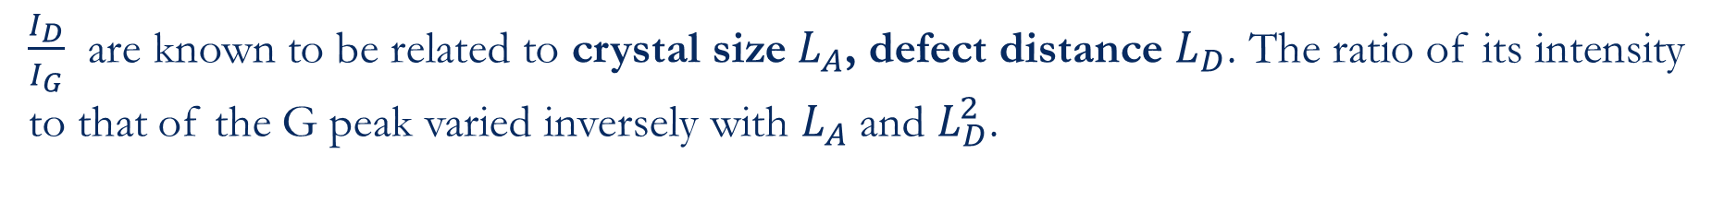
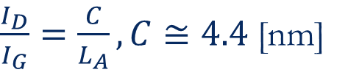
Defects and Crystal Size
$\frac{I_{D}}{I_{G}}$ are known to be related to crystal size $L_{A}$, defect distance $L_{D}$. The ratio of its intensity to that of the G peak varied inversely with $L_{A}$ and $L_{D}^{2}$.
$\frac{I_{D}}{I_{G}}=\frac{C}{L_{A}}, C≅4.4$[nm]

Slide 16
Ti2CTx – Experiment Result
ω2
ω3
ω1
D
G

Slide 17
Conclusion
GR/GO/RGO
Defect increases, Crystal size decreases -> I(D) / I(G)
They are Multi-layer
Mxenes
A material(A) is etched.
Sp2 structure is weaken.
Using Raman Spectroscopy in this manner, change in chemical structure can be well detected. Also, there are more calculatable physical quantities. However, in this way, it is hard to see the band structure of electrons and phonons or the symmetry of the system. Raman spectroscopy is the result of them, the reverse process is quite different. To analyze the material, not only can Raman be used in a different manners, but there are many complementary methods such as FT-IR, TEM, STEM, that makes it possible to see Raman inactive modes.

Slide 18
References
[1] Ferrari, A., Basko, D. Raman spectroscopy as a versatile tool for studying the properties of graphene. Nature Nanotech 8, 235–246 (2013)
[2] Lim, Gim Pao et al. “Synthesis, characterization and biophysical evaluation of the 2D Ti2CTx MXene using 3D spheroid-type cultures.” Ceramics International (2021)
[3] Alhwaige, Almahdi A. et al. “Interactions, morphology and thermal stability of graphene-oxide reinforced polymer aerogels derived from star-like telechelic aldehyde-terminal benzoxazine resin.” RSC Advances 5 (2015)
[4] Hidayah, N. M. S. et al. “Comparison on graphite, graphene oxide and reduced graphene oxide: Synthesis and characterization.” (2017)
[5] Iqbal A, Hamdan NM. Investigation and Optimization of Mxene Functionalized Mesoporous Titania Films as Efficient Photoelectrodes. Materials. (2021)

Slide 19
Thank you

